Slide 1

Machine Learning – Certification Program (Aug 2018)
Code Assignment – Module 5
Phone : +91 9999658436
Offices : Bengaluru, New Delhi
Email : contact@cellstrat.com
Web : www.cellstrat.com
CellStrat™ Confidential. All Rights Reserved.

Slide 2
Module 5
Regression

Slide 3

Questions
1) Cell 1: Make changes in the create_y function to reduce the MSE in cell 4
2) Cell 2: Increase the test data to 20
linearRegression.ipynb file (Set 1 code)
Notes:
Merge Sort?

Slide 4
Questions
PolynomialRegression.ipynb file (Set 2 code)
Regression –Polynomial Regression
Tutorial name – Predict insurance premium per year based on person’s age
Exercise :-
Q1) Change the degree of the polynomial from (PolynomialFeatures(degree = 1)) from 1, 2, 3 and interpret the resulting regression plot. Which one underfitted, right-fitted and overfitted.
Q2) What is the insurance claim predicted for age 70 with (provide rough values) :-
Polynomial regression with degree 2
Linear Regression

Slide 5
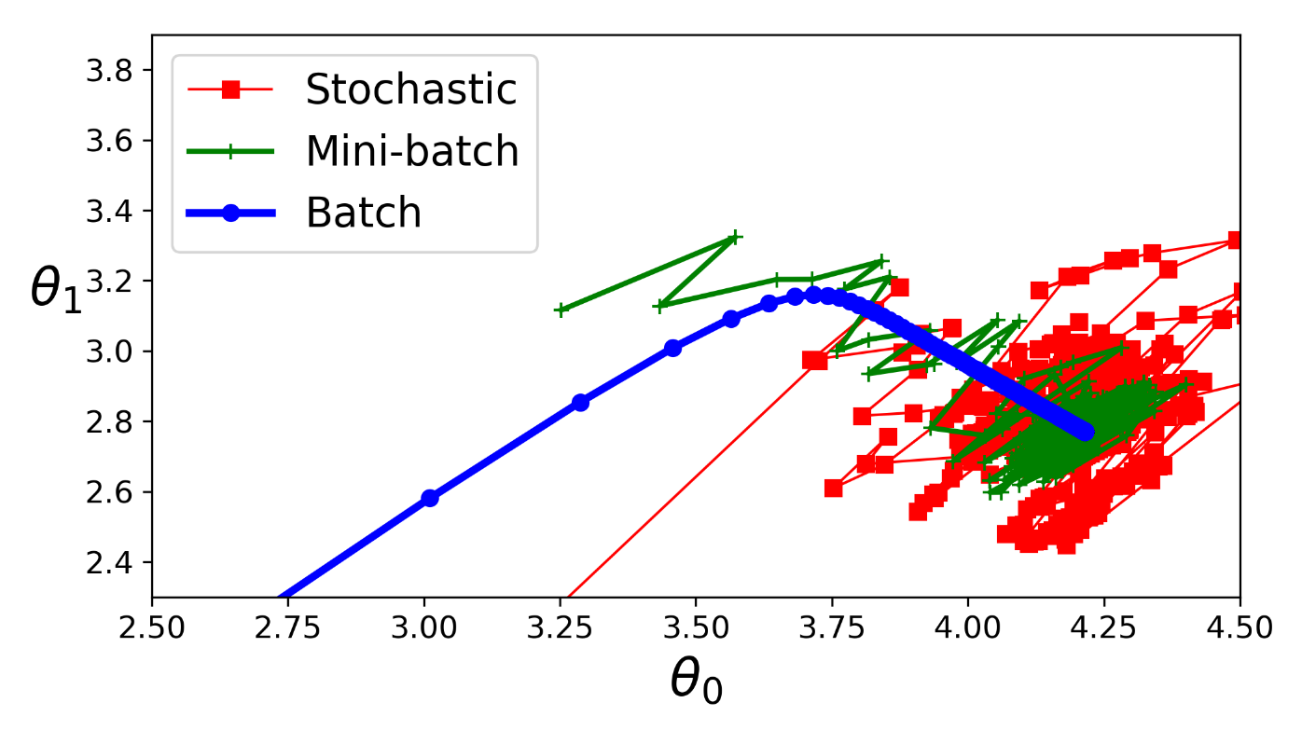
Questions
CellStrat - Linear and Polynomial Regression.ipynb file (Set 2 code)
Regression – Regression – CellStrat Linear and Polynomial Regression
Tutorial name – Demonstrate various regression techniques over a random dataset
Q1) What is the difference you see in the stochastic, mini-batch and batch gradient descent ? Interpret the results

Slide 6
Questions
CellStrat - Linear and Polynomial Regression.ipynb file (Set 2 code)
Regression – Regression – CellStrat Linear and Polynomial Regression
Tutorial name – Demonstrate various regression techniques over a random dataset
Q2) What is the ideal gradient descent from among stochastic, mini-batch or batch ?

Slide 7
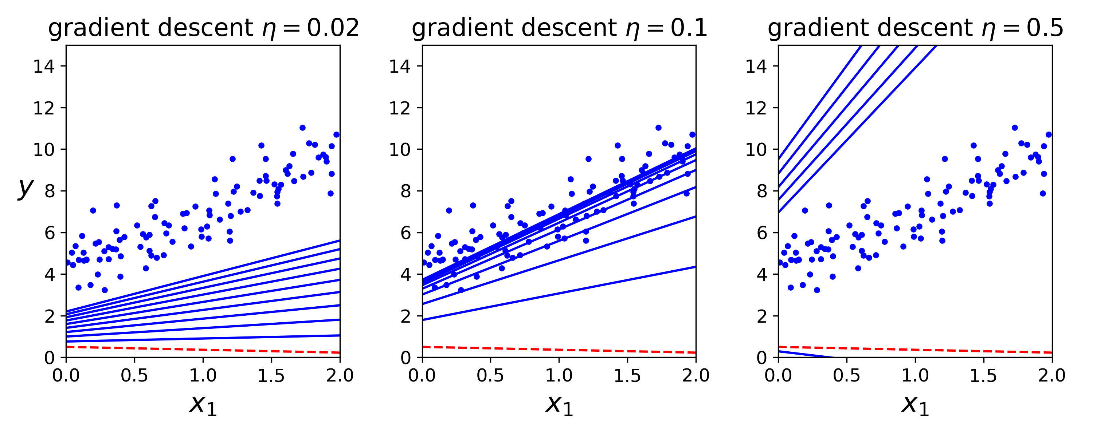
Questions
CellStrat - Linear and Polynomial Regression.ipynb file (Set 2 code)
Regression – Regression – CellStrat Linear and Polynomial Regression
Tutorial name – Demonstrate various regression techniques over a random dataset
Q3) The program depicts the learning process when the learning rate η is 0.02, 0.1 and 0.5. Please provide interpretation of these charts ?

Slide 8
Questions
CellStrat - Linear and Polynomial Regression.ipynb file (Set 2 code)
Regression – Regression – CellStrat Linear and Polynomial Regression
Tutorial name – Demonstrate various regression techniques over a random dataset
Q4) The program depicts the learning process when the learning rate η is 0.02, 0.1 and 0.5. Try changing the values to 0.001, 0.25 and 0.9 and check the results ? Provide interpretation

